Slide 1

MEDICAPS UNIVERSITY
2019-2020
Intern at Hvantage Technologies
Internal Guide
Prof.(Dr).Ruchi Patel
External Guide/Incharge
Mr. Neelesh jain
(Hvantage Technologies)
Submitted By:
Shubham Sharma(EN16CS2301257)

Slide 2
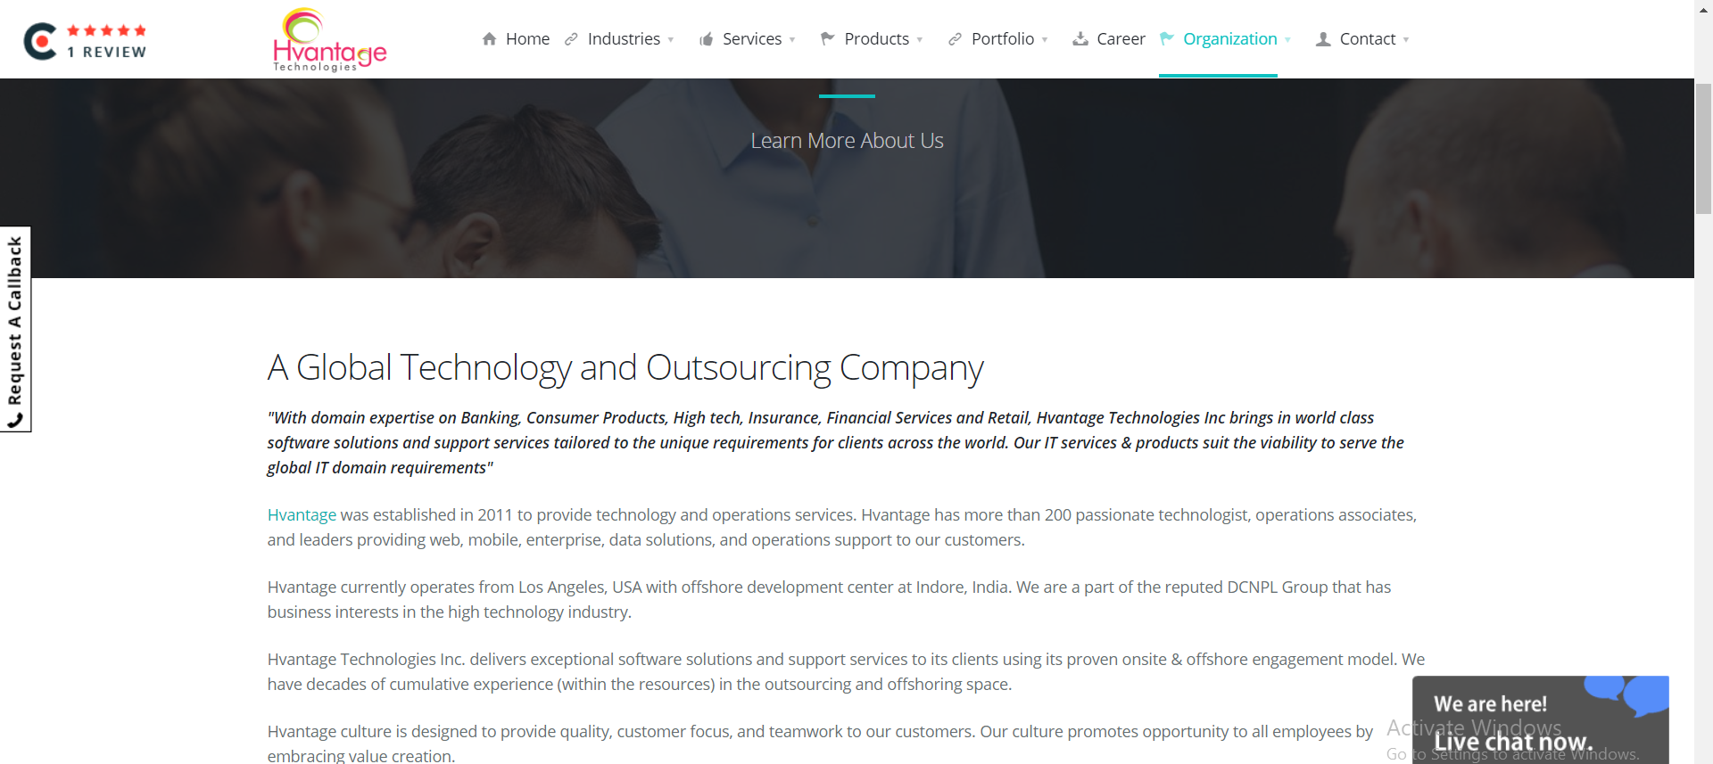
About Hvantage Technology:

Slide 3
Salad App
The online food ordering service for the local restaurant or application for customers to provide more interactive menu so that ordering process could be carried out.
Ordering Food online is designed for its more flexibility and performance and make sure that the system has enough navigation function through the picture information or significant logo guide customer

Slide 4
Technology Used
> PHP(core)
>Mysql
>RectNative

Slide 5
My Work
Worked on a Backend for the food delivery Application Which is based on Php and MYSQL (Database) .
Making API for mobile application
Tools used:
1. phpMYadmin
2. XAMPP Server
3. Postman

Slide 6
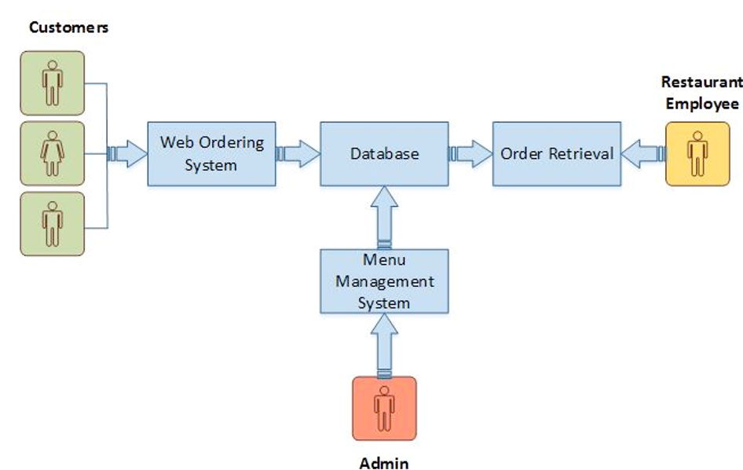
Block Diagram for Salad-App

Slide 7
Topics
Food delivery application
Backend of food delivery app
Driver application
Driver backend

Slide 8
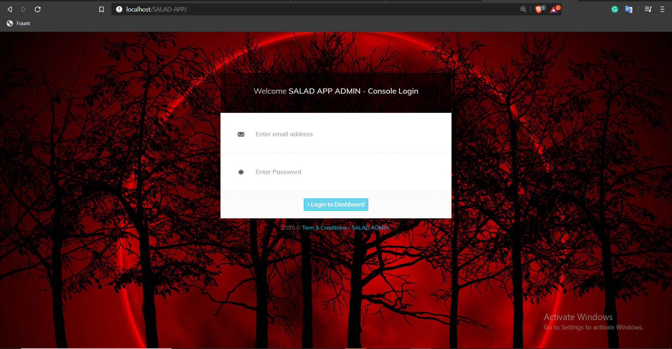
Admin Login Page

Slide 9
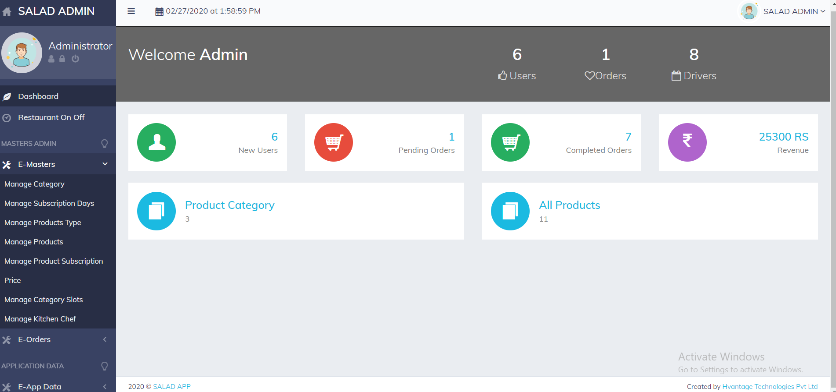
Admin Panel

Slide 10
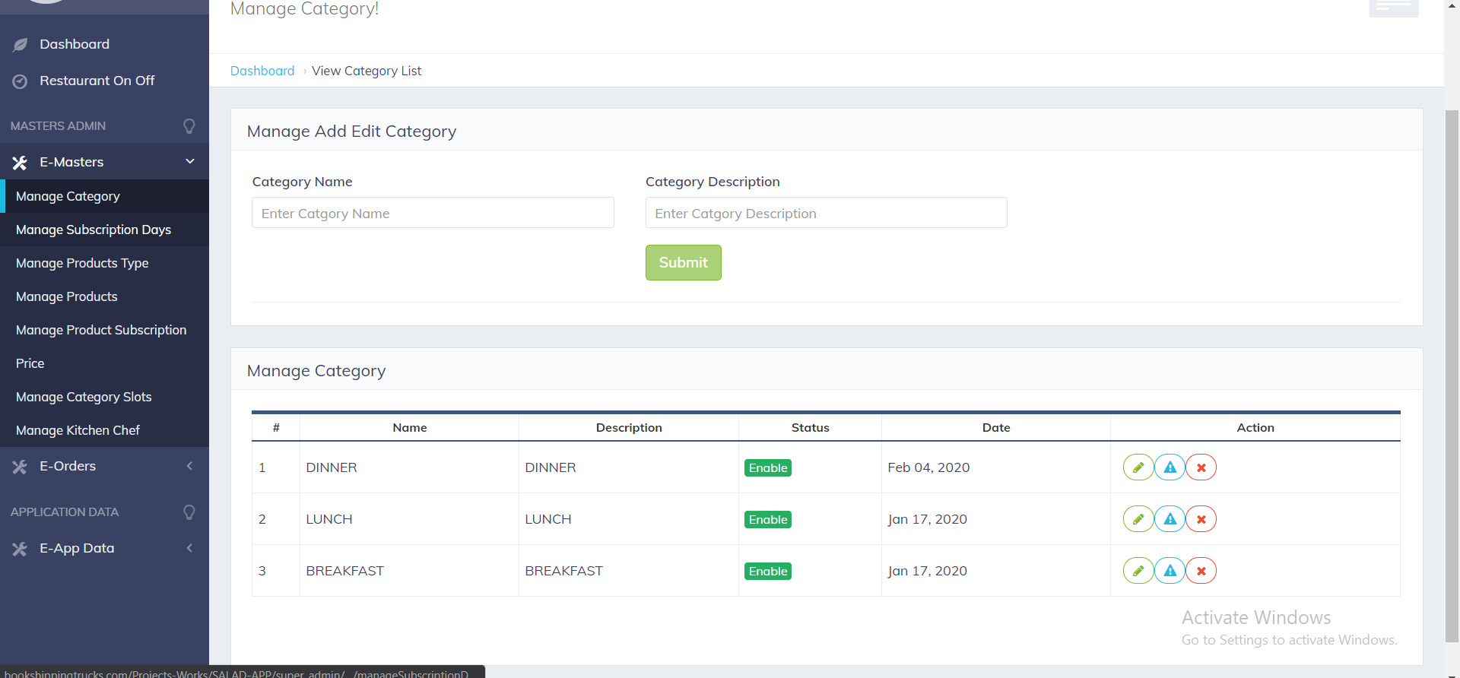
Adding Category Page

Slide 11
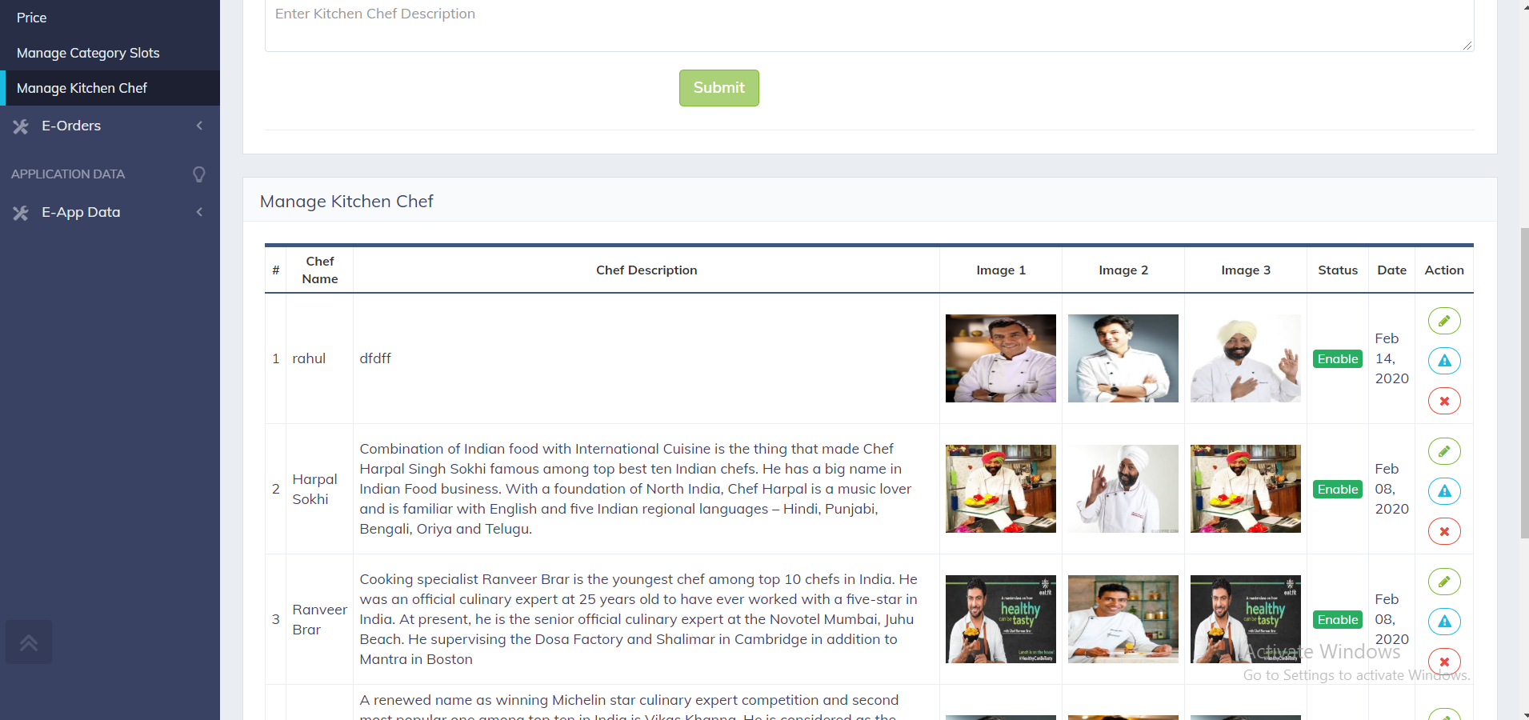
Adding Chef Page

Slide 12
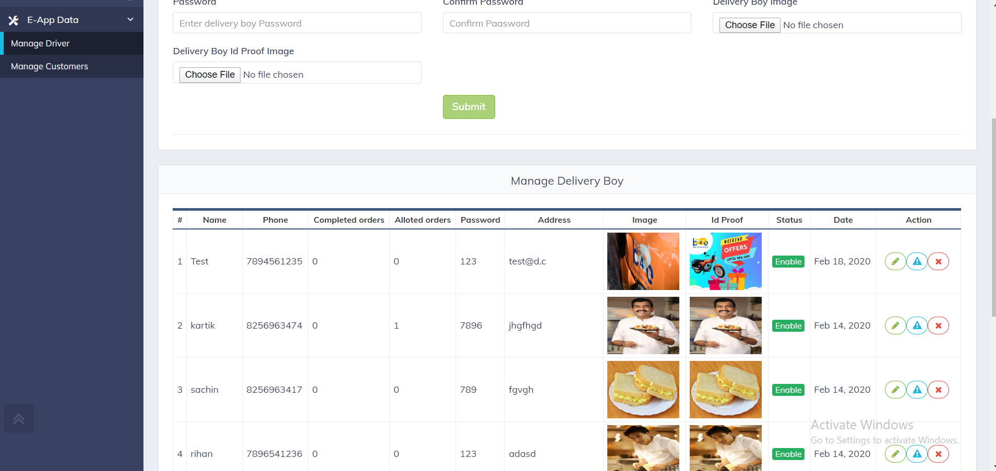
Adding Delivery Boy

Slide 13
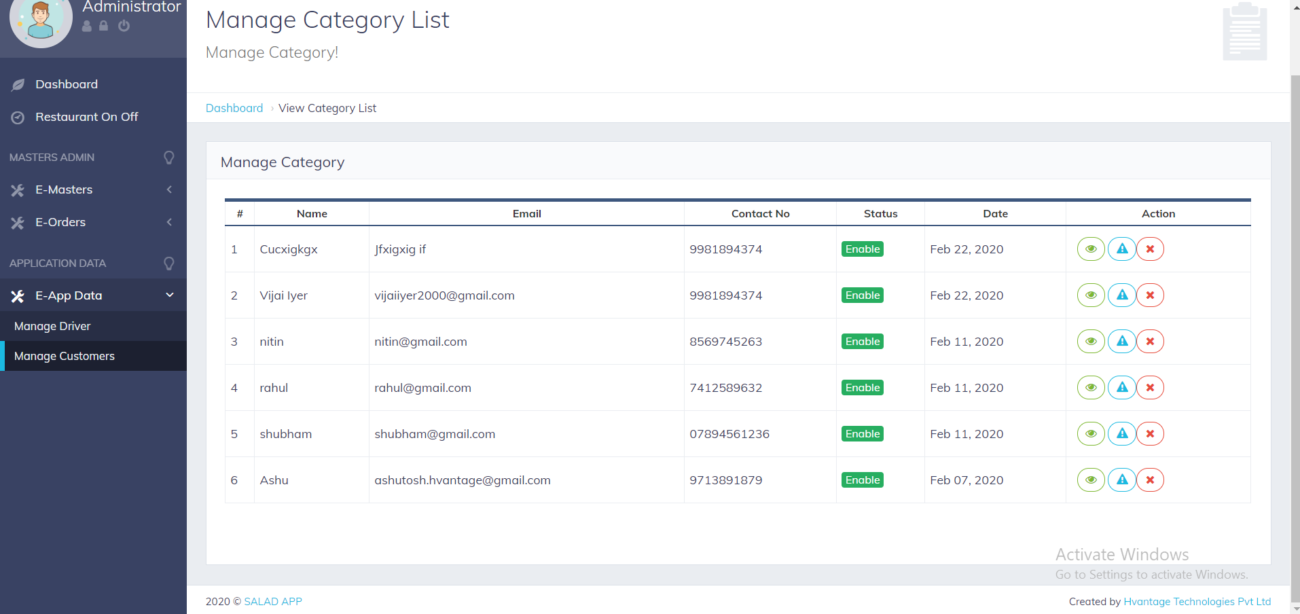
Manage Customer Page

Slide 14
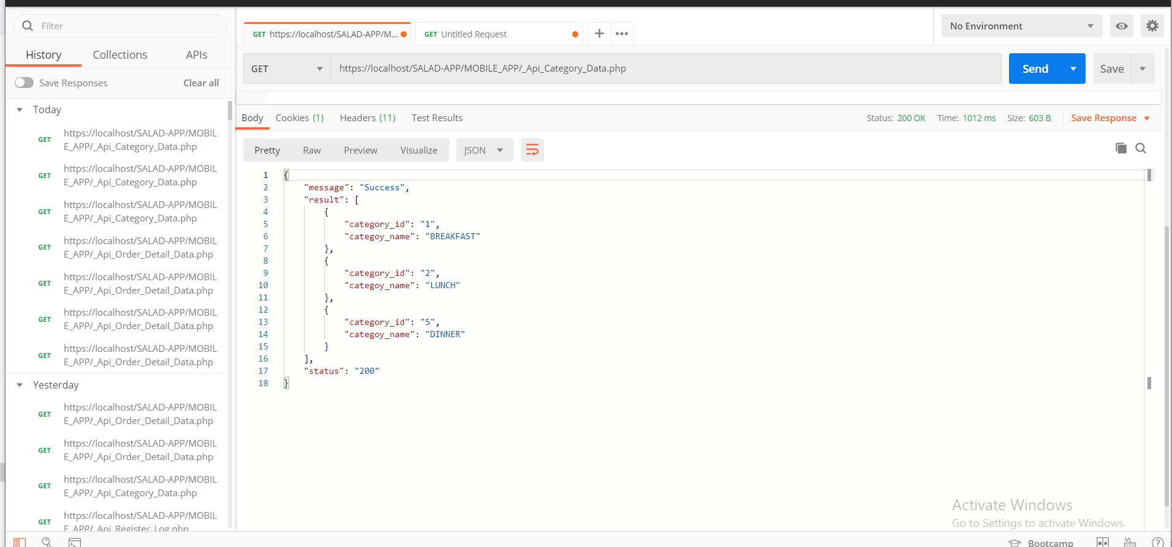
API for Salad-App

Slide 15
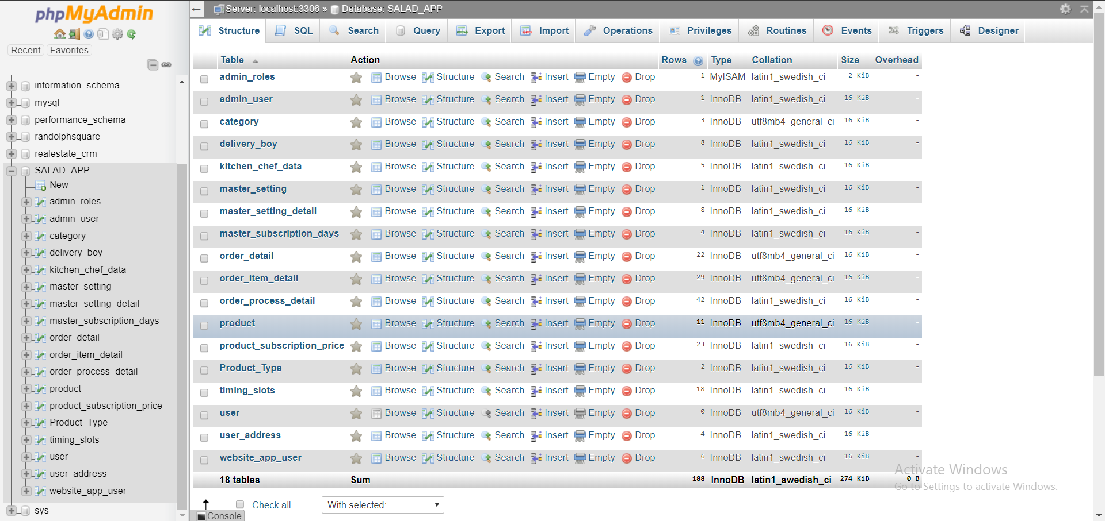

Slide 16
Future Scope
Payment Options: Add different payment options such as PayPal, Cash, Gift Cards etc. Allow to save payment details for future use.
Order Process Estimate: Provide customer a visual graphical order status bar.

Slide 17
Thank you

